Slide 1
Booster option valuation
Francesco Pace

Slide 2

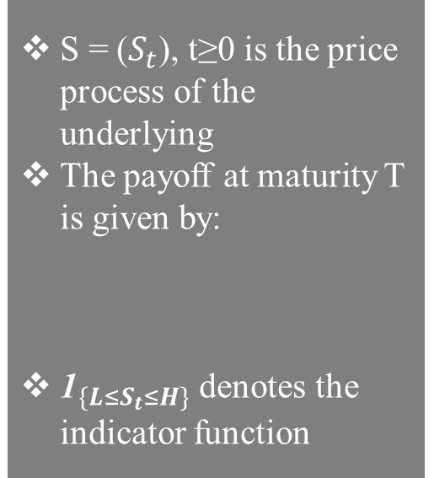
What is a Booster option?
Booster option is an exotic path-dependent derivative that is sometimes used in FX markets.
The derivative delivers a payoff at maturity that depends on the amount of time that the underlying spends between two barriers L (low) and H (high), with L < H.
S = ($S_{t}$), t≥0 is the price process of the underlying
The payoff at maturity T is given by:
${\text{1}}_{\{{L≤S}_{t}≤H\}}$ denotes the indicator function

Slide 3
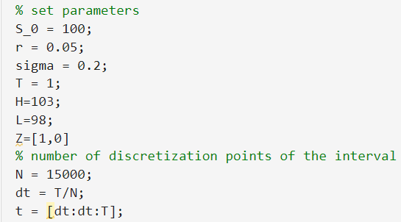
3 Methods of valuation
Feynman-Kac formula
Valuation using the Binomial model
Monte Carlo method

Slide 4
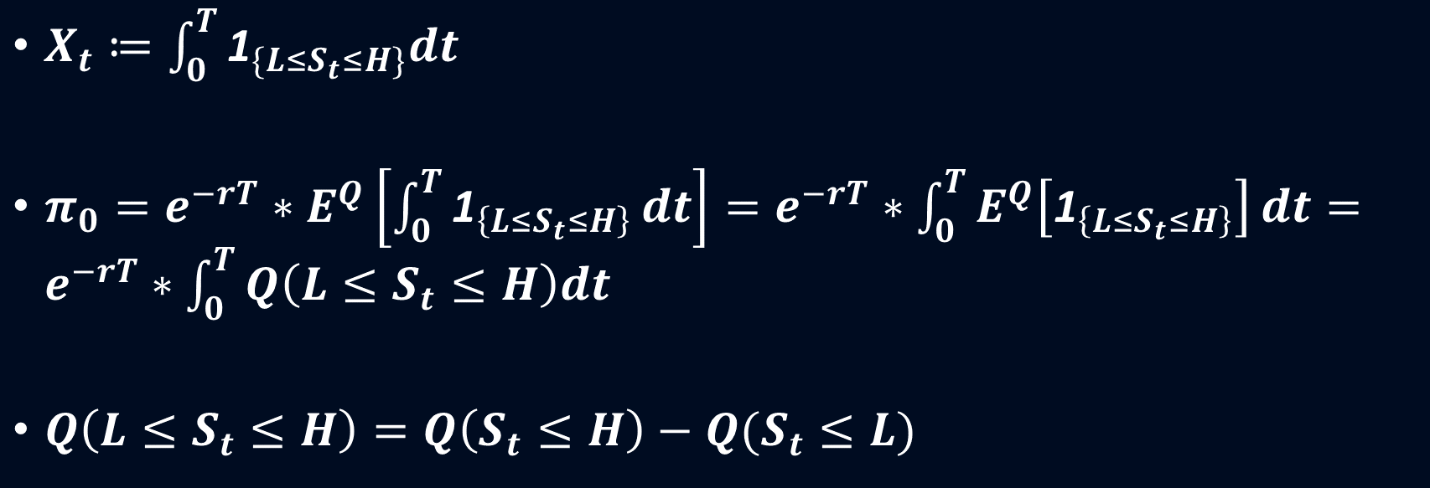
Feynman-Kac formula under Risk-neutral probability
$X_{t}≔\int_{0}^{T}{{\text{1}}_{\{{L≤S}_{t}≤H\}}dt}$
$π_{0}=e^{−rT}∗E^{Q}\left[\int_{0}^{T}{{\text{1}}_{\left\{{L≤S}_{t}≤H\right\}}}dt\right]=e^{−rT}∗\int_{0}^{T}{E^{Q}\left[{\text{1}}_{\left\{{L≤S}_{t}≤H\right\}}\right]}dt=e^{−rT}∗\int_{0}^{T}{Q\left(L≤S_{t}≤H\right)dt}$
$Q\left(L≤S_{t}≤H\right)=Q\left(S_{t}≤H\right)−Q(S_{t}≤L)$

Slide 5
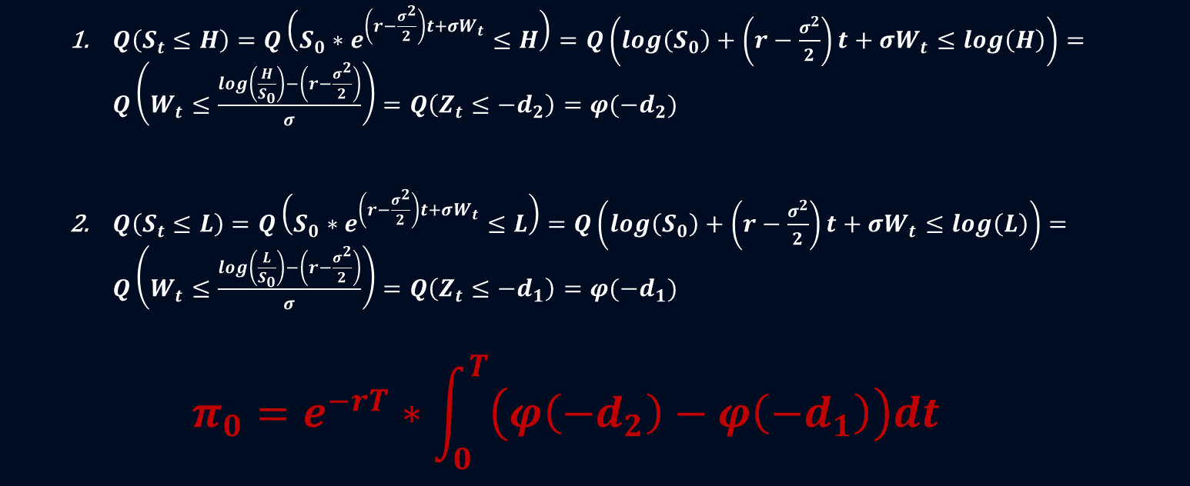
Feynman-Kac formula under Risk-neutral probability
$Q\left(S_{t}≤H\right)=Q\left(S_{0}∗e^{\left(r−\frac{σ^{2}}{2}\right)t+σW_{t}}≤H\right)=Q\left(\log\left(S_{0}\right)+\left(r−\frac{σ^{2}}{2}\right)t+σW_{t}≤\log\left(H\right)\right)=Q\left(W_{t}≤\frac{\log\left(\frac{H}{S_{0}}\right)−\left(r−\frac{σ^{2}}{2}\right)}{σ}\right)=Q\left(Z_{t}≤−d_{2}\right)=φ(−d_{2})$
$Q\left(S_{t}≤L\right)=Q\left(S_{0}∗e^{\left(r−\frac{σ^{2}}{2}\right)t+σW_{t}}≤L\right)=Q\left(\log\left(S_{0}\right)+\left(r−\frac{σ^{2}}{2}\right)t+σW_{t}≤\log\left(L\right)\right)=Q\left(W_{t}≤\frac{\log\left(\frac{L}{S_{0}}\right)−\left(r−\frac{σ^{2}}{2}\right)}{σ}\right)=Q\left(Z_{t}≤−d_{1}\right)=φ(−d_{1})$
$$π_{0}=e^{−rT}∗\int_{0}^{T}{\left(φ\left(−d_{2}\right)−φ\left(−d_{1}\right)\right)dt}$$

Slide 6
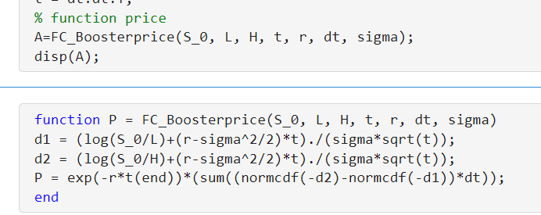
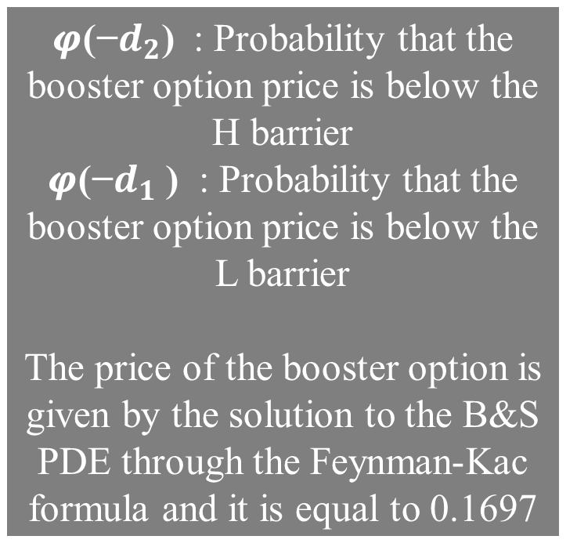
Feynman-Kac formula under Risk-neutral probability
𝝋(−$d_{2}$) : Probability that the booster option price is below the H barrier
𝝋(−$d_{1}$ ) : Probability that the booster option price is below the L barrier
The price of the booster option is given by the solution to the B&S PDE through the Feynman-Kac formula and it is equal to 0.1697

Slide 7
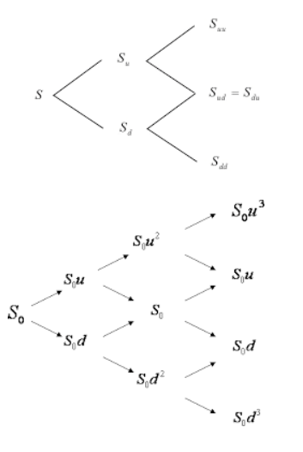
Binomial model
Path independent
Vs
Path dependent

Slide 8
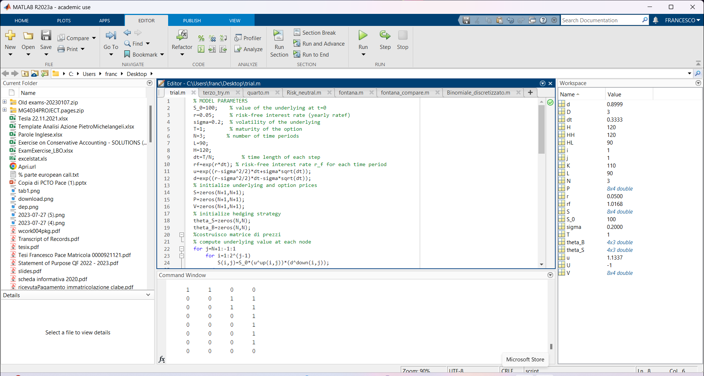
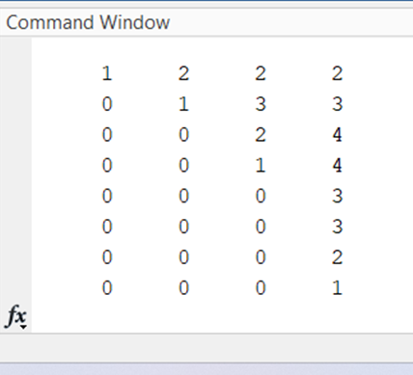
Binomial model
(1)
Binary matrix that shows which values of S are inside the interval (1)
Matrix that shows the different paths of final payoffs (2)
(2)

Slide 9
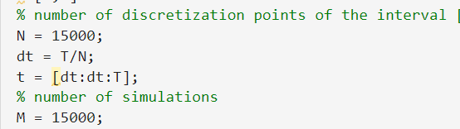
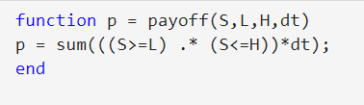

Monte Carlo method
In the case of the Booster option, the sum of areas between the barriers has to be made for each dt.
Model is simple to implement and the fact that it doesn’t require many computations to be made enables it to easily work with a large number of simulations.

Slide 10
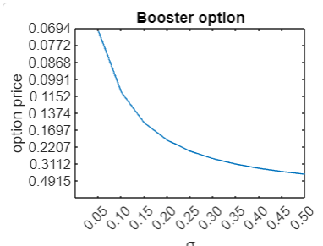
Volatility analysis
In the case of the Booster option there is a negative correlation, which is expected since the payoff depends on the time the price of the underlying spent between the bounds H and L.

Slide 11
Conclusions:
Risk-neutral valuation is the most efficient because it isn’t an approximation, so we use it as a benchmark
The Binomial model is the least efficient, since the code requires many computations. Hence our computer is not able to perform the simulation for a large number of periods.
Monte Carlo is using the “Law of Large numbers” so it gives a more accurate result the higher the number of experiments M. The model was easy to implement and the price was the close to the benchmark
As expected the price of the Booster option decreases with the increase in the volatility.

Slide 12
THANK YOU FOR YOUR ATTENTION!

